Slide 1
Computer graphics section 3
Dr : heba elhadidy
Eng : mariyam khashapa

Slide 2
Turtle methods
colorMode ( ) : Return the colormode or set it to 1.0 or 255. Subsequently r, g, b values of color triples have to be in the range 0..cmode, 1 means using string color and 255 means using rgb color
Example : tu.colorMode(255) → tu.color(255,0,0)
setx ( ) , sety ( ) : set the turtle coordinates without changing the other value
Example : tu.setx(30)
setheading\seth (angel) : Set the orientation of the turtle to angle
Example : tu.setheading (90)
Reset ( ) : Delete the turtle’s drawings from the screen, re-center the turtle and set variables to the default values.
Clear ( ) : Delete the turtle’s drawings from the screen. Do not move turtle. State and position of the turtle as well as drawings of other turtles are not affected.

Slide 3
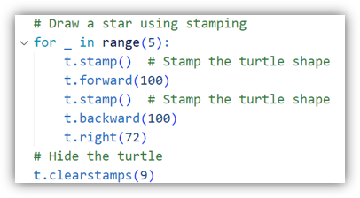
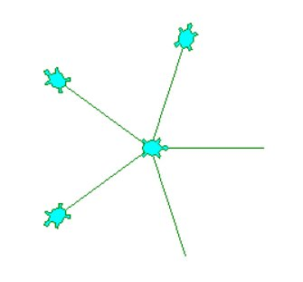
stamp( ) : Stamp a copy of the turtle shape onto the canvas at the current turtle position. Return a stamp_id for that stamp, which can be used to delete it
clearstamp (stamp_id) : Delete stamp with given stamp_id.
clearstamps (stamp_id) : Delete all or first/last n of turtle’s stamps. If n is None, delete all stamps, if n > 0 delete first n stamps, else if n < 0 delete last n stamps.

Slide 4
towards (x, y) : x – a number or a pair/vector of numbers or a turtle instance, y – a number if x is a number, else None → Return the angle between the line from turtle position to position specified by (x,y), the vector or the other turtle. This depends on the turtle’s start orientation
Xcor, ycor ( ) : return turtle’s x or y coordinate
hideturtle \ ht ( ) : Make the turtle invisible. It’s a good idea to do this while you’re in the middle of doing some complex drawing, because hiding the turtle speeds up the drawing observably.
showturtle \ st ( ) : Make the turtle visible
isvisable ( ) : Return True if the Turtle is shown, False if it’s hidden
resizemode (mode) : Set resizemode to one of the values: “auto” → value of pensize, “user” → values of stretchfactor and outlinewidth from pen function, “noresize” → no adaption of the turtle’s appearance takes place.. If mode is not given, return current resizemode

Slide 5
shapesize (stretch_wid, stretch_len, outline=None) \ turtlesize : Return or set the pen’s attributes x/y- stretchfactors and/or outline. Set resizemode to “user”. If and only if resizemode is set to “user”, the turtle will be displayed stretched according to its stretchfactors: stretch_wid is stretchfactor perpendicular to its orientation, stretch_len is stretchfactor in direction of its orientation, outline determines the width of the shapes' outline.

Slide 6
Pen(pen, pendict) :
pen – a dictionary with some or all of the below listed keys
pendict – one or more keyword-arguments with the below listed keys as keywords
“shown”: True/False
“pendown”: True/False
“pencolor”: color-string or color-tuple
“fillcolor”: color-string or color-tuple
“pensize”: positive number
“speed”: number in range 0..10
“resizemode”: “auto” or “user” or “noresize”
“stretchfactor”: (positive number, positive number)
“outline”: positive number
“tilt”: number
isdown ( ) : Return True if pen is down, False if it’s up.

Slide 7
screensize (width, high, color) : If no arguments are given, return current width and high else resize the screen
Example : turtle.screensize (500,500,”red”)
setworldcoordinates (x1,y1,x2,y2) : Set up user-defined coordinate system and switch to mode “world” if necessary. This performs a screenreset( ). If mode “world” is already active, all drawings are redrawn according to the new coordinates
Example : turtle.setwoldcoords ( -50,-7.5,50,7.5)

Slide 8
shearfactor (number) عامل القص: Set or return the current shearfactor. Shear the turtleshape according to the given shearfactor shear, which is the tangent of the shear angle. Do not change the turtle’s heading (direction of movement). If shear is not given: return the current shearfactor, I. e. the tangent of the shear angle, by which lines parallel to the heading of the turtle are sheared.
Example : turtle.shearfactor (0.5)
tilt (angel) : Rotate the turtleshape by angle from its current tilt-angle, but do not change the turtle’s heading (direction of movement).
Example : turtle.tilt (45)
settiltangle (angel) = tiltangel (angel) : Rotate the turtleshape to point in the direction specified by angle, regardless of its current tilt-angle. Don’t change the turtle’s heading (direction of movement).
Example : turtle.settiltangle (45)

Slide 9


shapetransform (t11,t12,t21,t22) : Set or return the current transformation matrix of the turtle shape, t11&t12 are the first row of matrix and t21&t22 are the second row, note that The determinant (t11 * t22 - t12 * t21) must not be zero, otherwise an error is raised
Example :
get_shapepoly ( ) : Return the current shape polygon as tuple of coordinate pairs. This can be used to define a new shape or components of a compound shape.

Slide 10
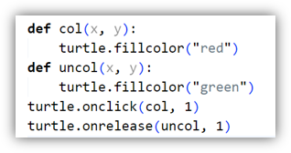

onclick (fun, btn, add) / onscreenclick : Bind fun to mouse-click events on this turtle. If fun is None, existing bindings are removed.
fun – a function with two arguments which will be called with the coordinates of the clicked point on the canvas
btn – number of the mouse-button, defaults to 1 (left mouse button)
add – True or False – if True, a new binding will be added, otherwise it will replace a former binding
Example : def turn(x, y) : turtle.left (90) turtle.onclick(turn,1,True)
onrelease (fun, btn, add) : Bind fun to mouse-button-release events on this turtle. If fun is None, existing bindings are removed.
Example :
ondrag (fun, btn, add) : Bind fun to mouse-move events on this turtle. If fun is None, existing bindings are removed.​
Remark: Every sequence of mouse-move-events on a turtle is preceded by a mouse-click event on that turtle.​
Example :

Slide 11
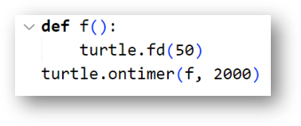
listen ( ) : Set focus on TurtleScreen (in order to collect key-events).
onkey / onkeyrelease (fun, key) : Bind fun to key-release event of key. If fun is None, event bindings are removed. Remark: in order to be able to register key-events, TurtleScreen must have the focus
Example : def f ( ): turtle.fd(50) turtle.lt(60)
turtle.onkey(f, "Up") turtle.listen( )
ontimer (fun, t) : Install a timer that calls fun after t milliseconds
Example:.
delay (num) : Set or return the drawing delay in milliseconds. (This is approximately the time interval between two consecutive canvas updates.) The longer the drawing delay, the slower the animation.​
Example : turtle.delay (1004)​
tracer (n, delay) : Turn turtle animation on/off and set delay for update drawings. If n is given, only each n-th regular screen update is really performed. (Can be used to accelerate the drawing of complex graphics.) When called without arguments, returns the currently stored value of n. Second argument sets delay value ​
Example : turtle.tracer(1,25)

Slide 12
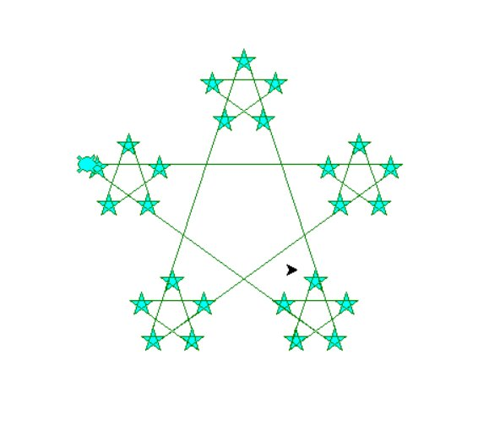
examples
let’s make this star
Note that star angle = 216

Slide 13
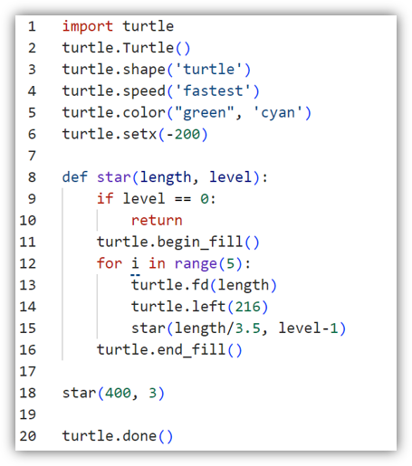

Slide 14
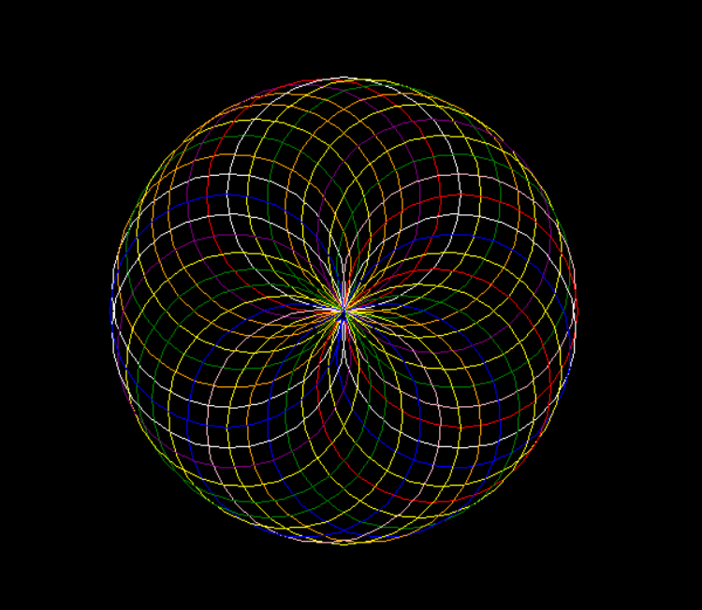
import turtle
import random
t = turtle.Turtle()
t.speed(0)
turtle.bgcolor("black")
colors = ["red", "blue", "green", "yellow", "purple", "orange", "pink", "white"]
for i in range(100):
t.pencolor(random.choice(colors))
t.circle(100)
t.right(10)
turtle.done()

Slide 15
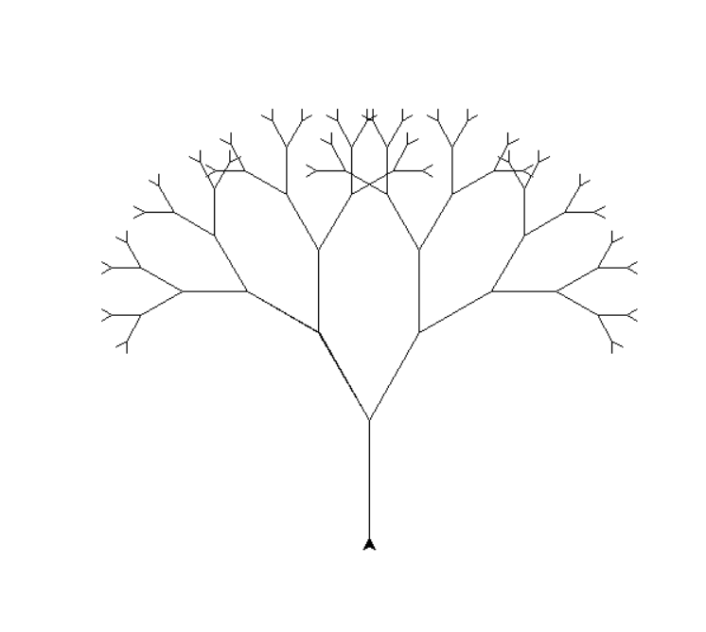

Slide 16
import turtle
t = turtle.Turtle()
t.speed(0)
t.left(90) # Start facing upward
def draw_branch(length):
if length < 5:
return
t.forward(length)
t.left(30)
draw_branch(length - 15)
t.right(60)
draw_branch(length - 15)
t.left(30)
t.backward(length
t.penup()
t.goto(0, -200)
t.pendown()
draw_branch(100)
turtle.done()

Slide 17
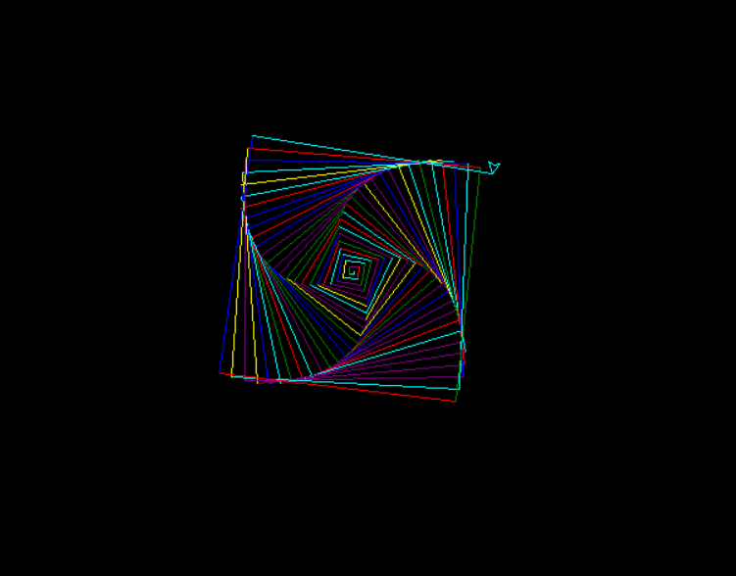

Slide 18
import turtle
import random
t = turtle.Turtle()
t.speed(0)
turtle.bgcolor("black")
colors = ["red", "blue", "green", "purple", "yellow", "cyan"]
for i in range(100):
t.pencolor(random.choice(colors))
t.forward(i * 2)
t.right(91) # Try changing to 89 or 92 for different effects!
turtle.done()

Slide 19
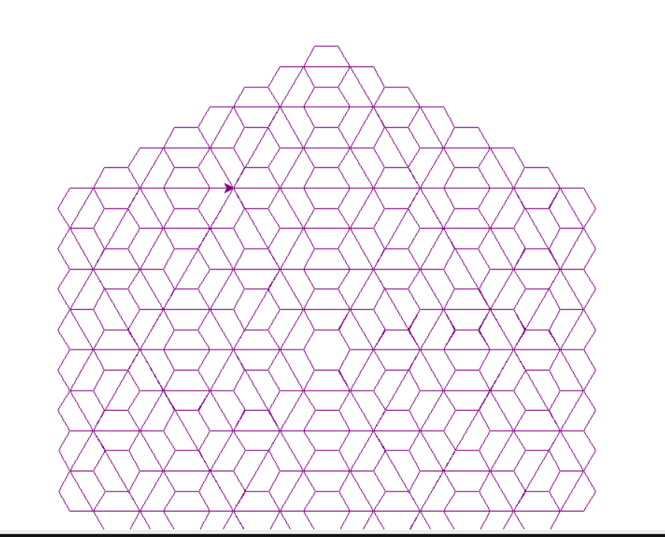

Slide 20
import turtle
t = turtle.Turtle()
t.speed(0)
t.color("purple")
def hexagon(size, depth):
if depth == 0:
return
for _ in range(6):
t.forward(size)
hexagon(size / 2, depth - 1)
t.right(60)
t.penup()
t.goto(-100, 50)
t.pendown()
hexagon(200, 4)
turtle.done()

Slide 21
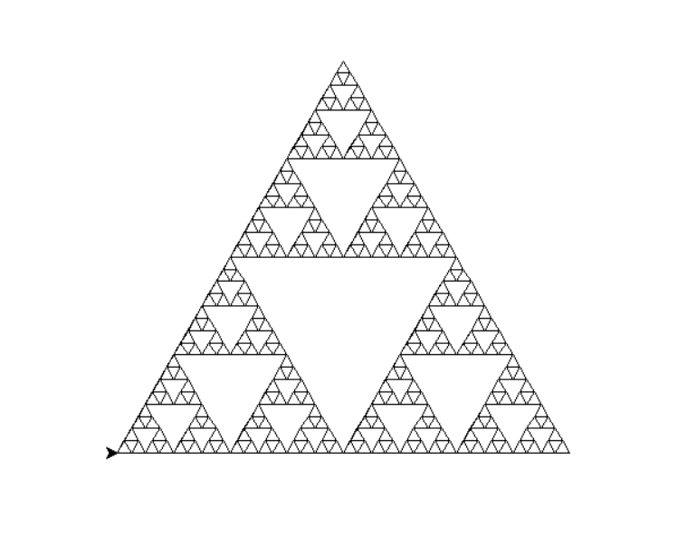

Slide 22
import turtle
t = turtle.Turtle()
t.speed(0)
def sierpinski(size, depth):
if depth == 0:
for _ in range(3):
t.forward(size)
t.left(120)
else:
sierpinski(size / 2, depth - 1)
t.forward(size / 2)
sierpinski(size / 2, depth - 1)
t.backward(size / 2)
t.left(60)
t.forward(size / 2)
t.right(60)
sierpinski(size / 2, depth - 1)
t.left(60)
t.backward(size / 2)
t.right(60)
t.penup()
t.goto(-200, -100)
t.pendown()
sierpinski(400, 5) # Increase depth for more detail
turtle.done()

Slide 23
Thank you

